Slide 1
Project: AirBnB Investment in Property in Washington, D.C - Prompt 3 – Neighborhood popularity
Objective
Data Methodology
Key Callouts and Recommendations to invest in AirBnB property
Objective of this analysis is to recommend the neighborhood that host most number of listings in Washington, D.C.
Data Methodology:
Data Source - AirProject 1_DC AirBnB raw data
Steps used to clean the data
Created copy of the original file, and retained original file for reference
Removed the duplicates for host_ids
Standardized names of the “Neighborhoods”
Key Call-outs:
Top 10 neighborhoods contributes to 69% of the highest listings
Off which 67% of the listings are for Apartments, while 30% is for house
Average price per listing per property is $155 in this neighborhood
71% of the houses and 64% of the apartments are rated excellent

Slide 2
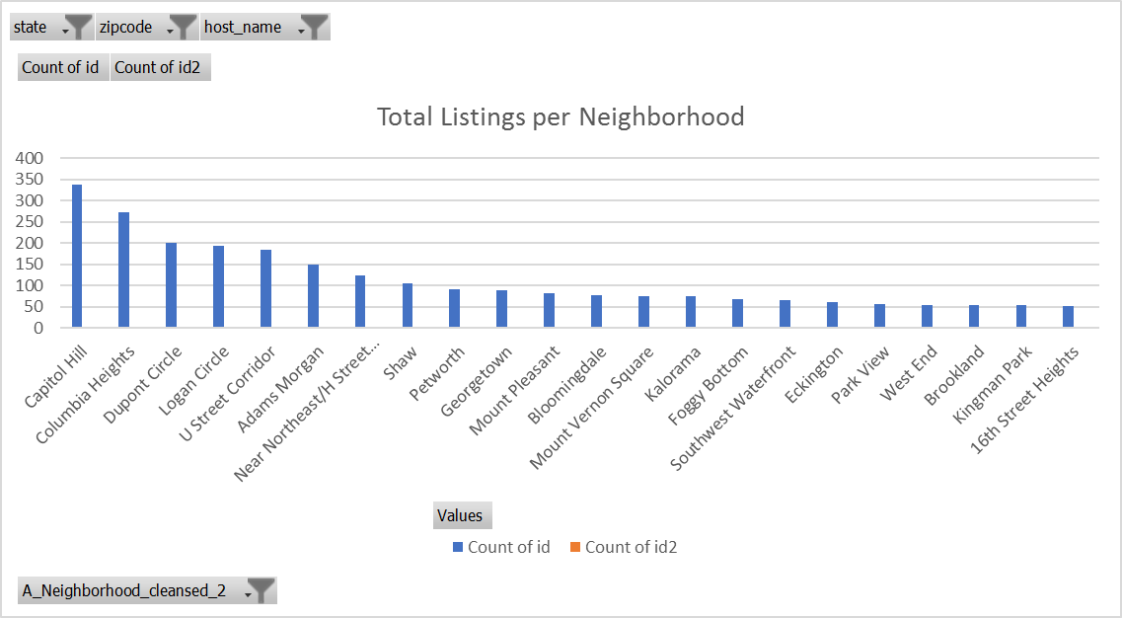
Recommendation: Neighborhoods that host the most listings by listing ID:
Top 10 neighborhoods lists about 69% of the listings. Investing in these top 10 neighborhoods will contribute to continued revenue inflow
Off which Capitol hill, Columbia Heights, and DuPont Circle contributes to 32% of the total listings
Methodology:
1. Considered neighborhoods listings greater than 50 only
2. Shows listings for state "DC" only
3. Filtered for blanks in Zip Code and Host_Name

Slide 3
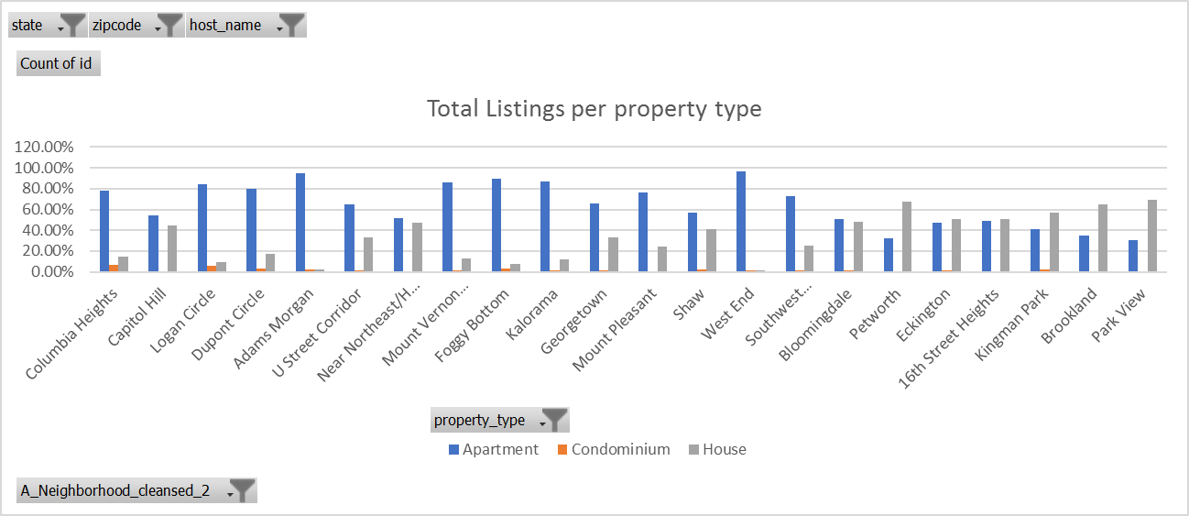
Recommendation (contd.): Neighborhoods host the most listings by property:
Recommend to invest in Apartment and House property type in these neighborhoods as 67% of listings are listed for property type Apartments, while 30% is listed for property type houses
Methodology:
1. Considered neighborhoods listings greater than 50 only
2. Considered property type listings greater than 50 only
3. Shows listings for state "DC" only
4. Filtered for blanks in Zip Code and Host_Name

Slide 4
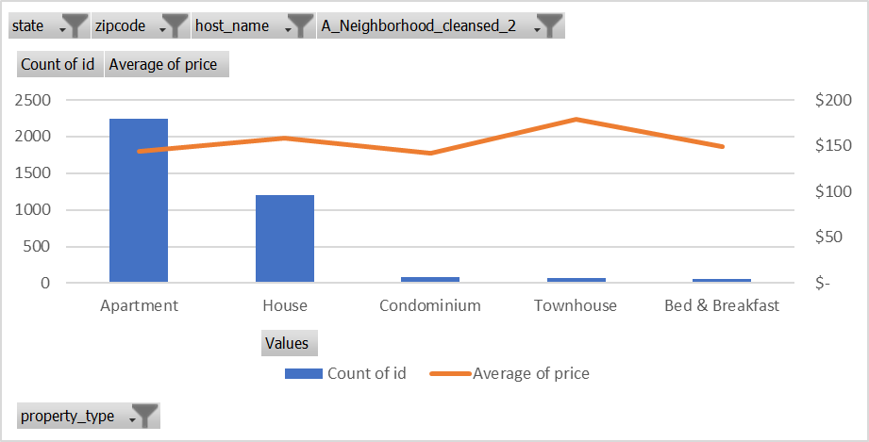
Recommendation (contd.): Neighborhoods host the most listings by Avg. Price in $
Investing in Apartments will yield continuous inflow of the revenue because of the occupancy rate (number of stays)
Methodology:
1. Considered neighborhoods listings greater than 50 only
2. Shows listings for state "DC" only
3. Filtered for blanks in Zip Code and Host_Name

Slide 5
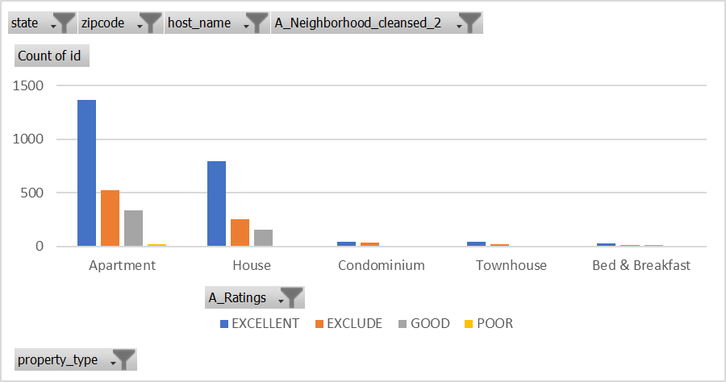
Recommendation (contd.): Neighborhoods host the most listings by Ratings
In these neighborhoods, Apartments and house are rated excellent by the customers
Methodology:
1. Considered neighborhoods listings greater than 50 only
2. Shows listings for state "DC" only
3. Filtered for blanks in Zip Code and Host_Name
4. Filtered for blanks in the Ratings

